Slide 1
Data Governance

Slide 2





Agenda
02
04
Business Benefits of Data Governance
Databricks & It’s Role in Data Governance
01
03
05
What Is the Data Governance
Key Elements of Data Governance
Cost & Conclusion

Slide 3
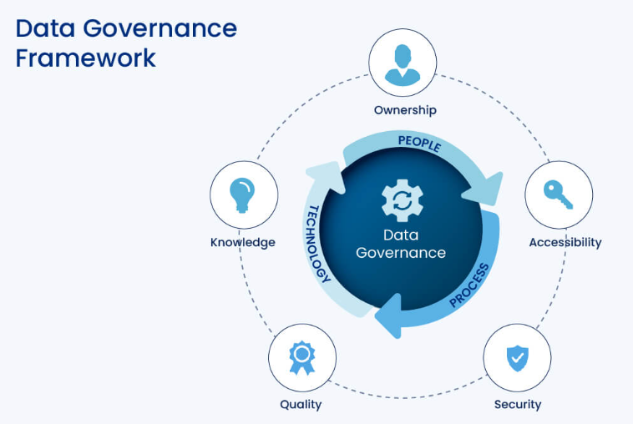
What is The Data Governance
Data Governance refers to the overall management of data availability, usability, integrity, and security in an organization.

Slide 4
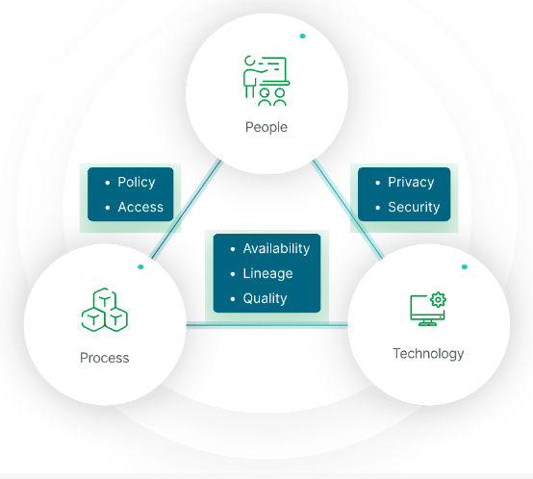
Importance of Data Governance
The primary benefit of data governance is providing the high-quality data necessary for data analytics and BI tools. The insights gained from these tools result in better business decisions and improved performance. Additional benefits include:
Improved data accuracy, completeness, and consistency
Prevention of data misuse
Agreement on common data definitions
Removal of data silos between departments and systems
Increased trust in data for analytics and decision making
Easier to locate data making all data more available
Better compliance with data privacy laws and other government regulations such as the EU General Data Protection Regulation (GDPR) and the US Health Insurance Portability and Accountability Act (HIPAA)

Slide 5
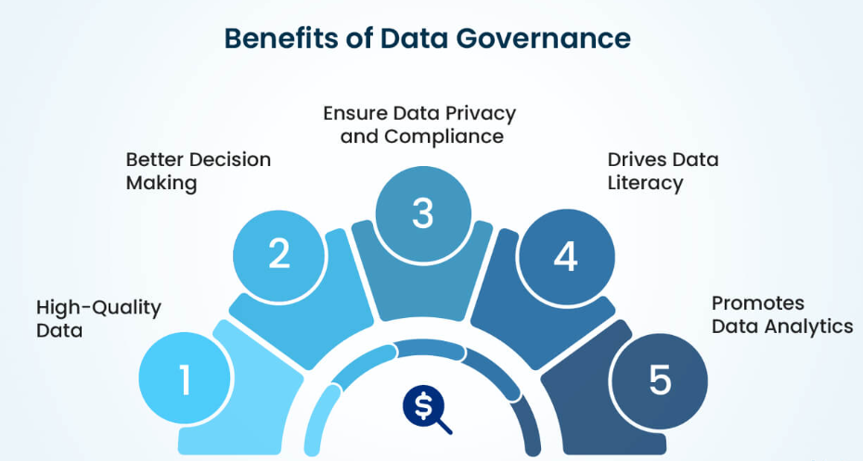
Business Benefits of Data Governance

Slide 6
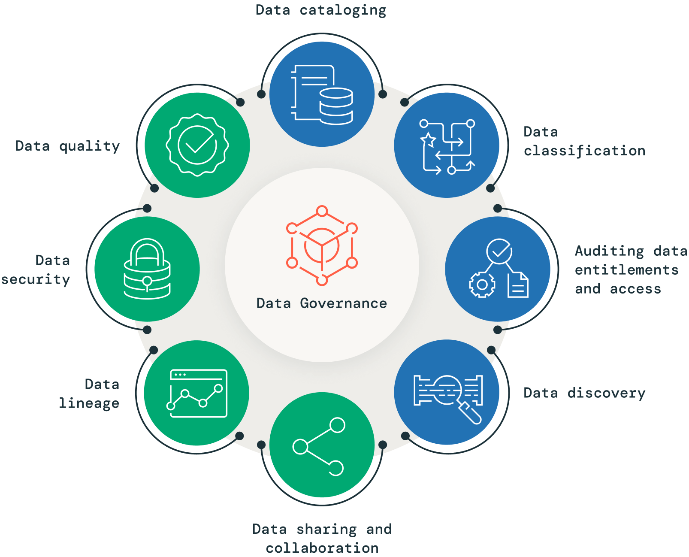
Key Elements of Data Governance

Slide 7

Databricks & It’s Role in Data Governance
Copyright © 2024 Cybage Software Pvt. Ltd. All Rights Reserved. Cybage Confidential.
www.cybage.com

Slide 8
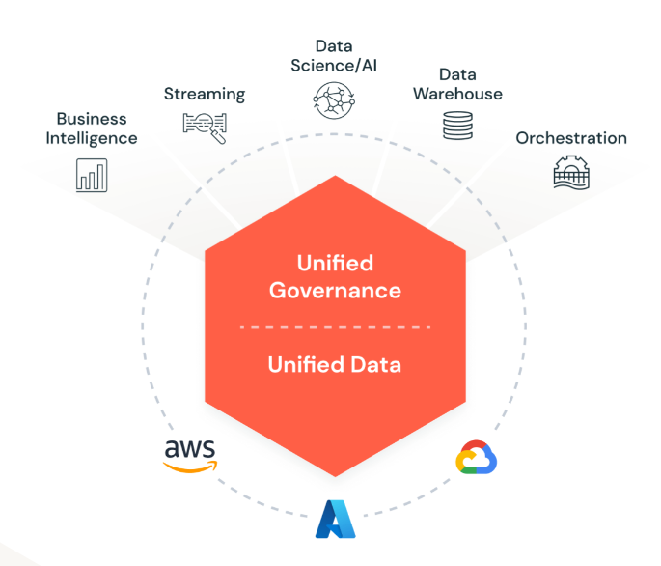

Overview Of Databricks
Databricks is a unified data platform built for big data analytics, AI, and machine learning. It simplifies and secures data workflows while enabling strong data governance at scale.
How Databricks Supports Data Governance:
🔍 Unity Catalog – Centralized metadata management and data discovery
🔐 Fine-Grained Access Controls – Secure data down to row/column levels
📈 Data Lineage Tracking – Full visibility of data flow and transformation
📜 Audit & Compliance – Built-in logging and monitoring for regulations (e.g., GDPR, HIPAA)
Collaboration – Secure data sharing across teams and clouds.
Heading
Heading
Heading
Heading
Heading
Heading

Slide 9
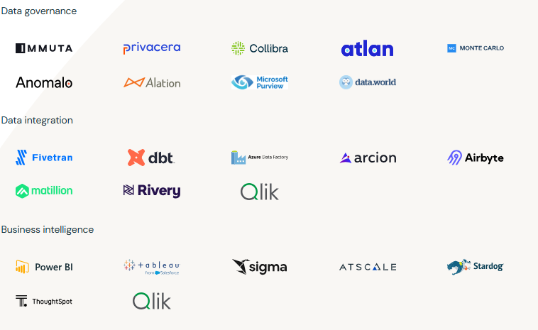
How Databricks useful in Data Governance
Databricks provides tools for data lineage, data quality, and data security. It supports regulatory compliance and offers robust data management capabilities.
Heading
Heading
Heading
Heading
Heading
Heading

Slide 10
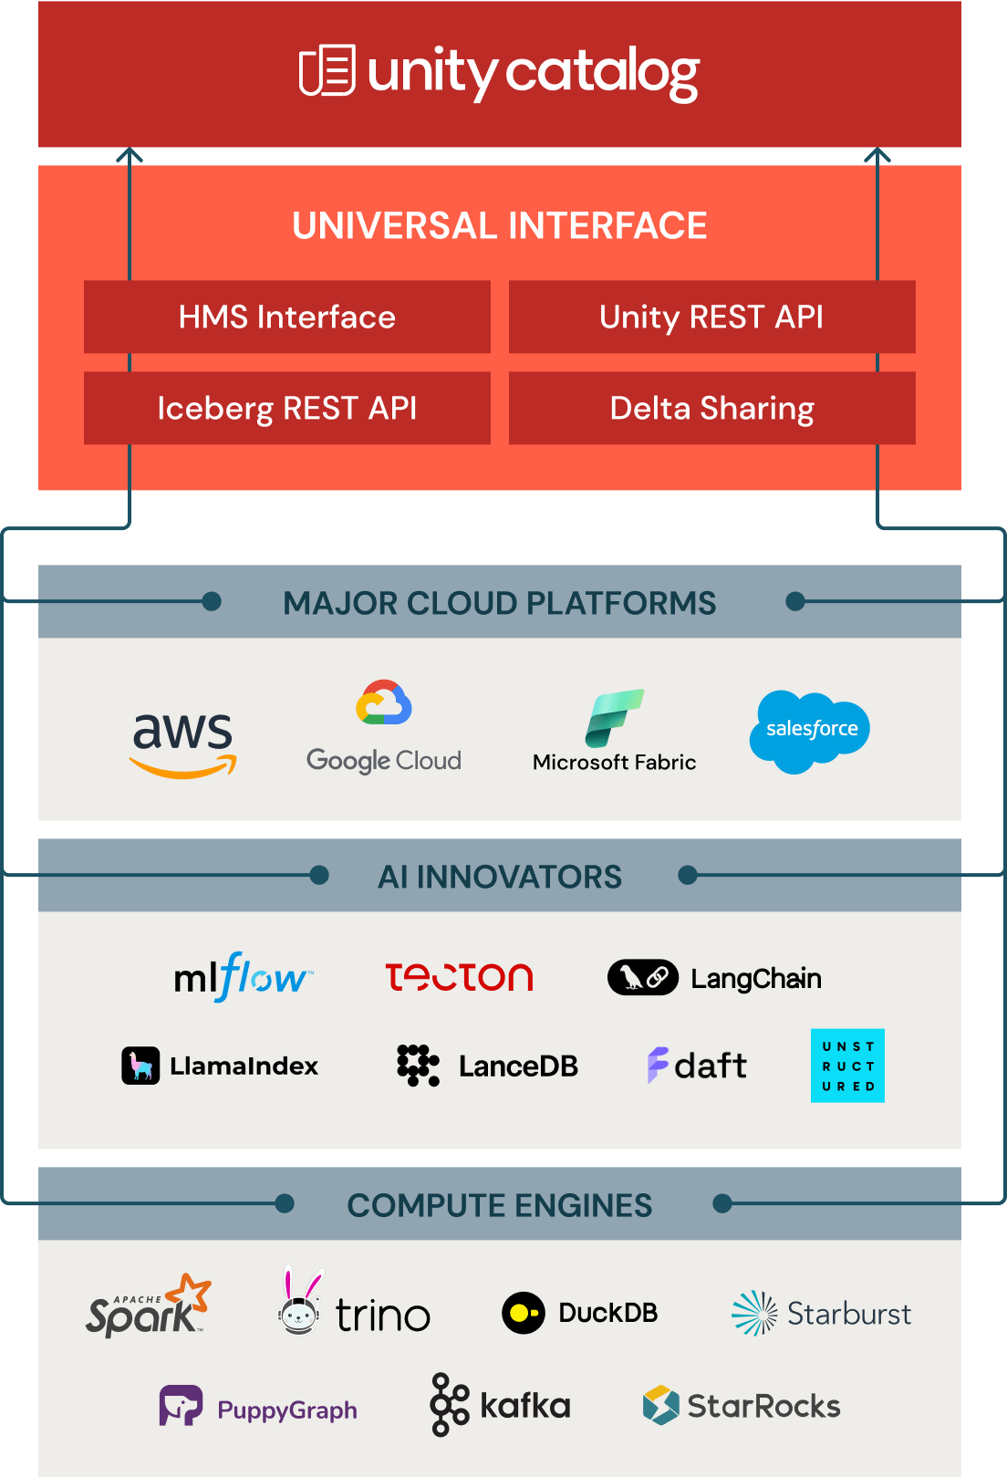
Unity Catalog
Unity Catalog is a fine-grained governance solution for data and AI on the Databricks platform. It helps simplify security and governance of your data by providing a central place to administer and audit data access. Delta Sharing is a secure data sharing platform that lets you share data in Databricks with users outside your organization. It uses Unity Catalog to manage and audit sharing behavior.
Heading
Heading
Heading
Heading
Heading
Heading

Slide 11
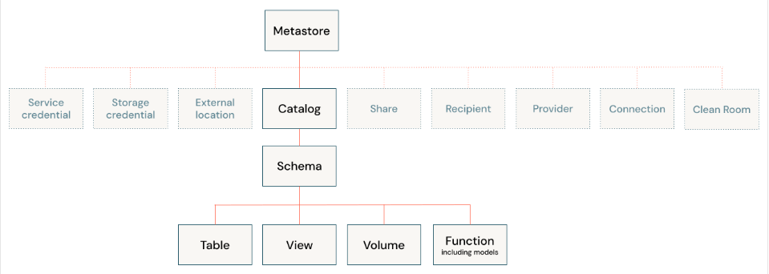
Data governance and data isolation building blocks
Heading
Heading
Heading
Heading
Heading
Heading

Slide 12
Data Hierarchy In Unity Catalog
Metastore: A metastore is the top-level container of objects in Unity Catalog. Metastores live at the account level and function as the top of the pyramid in the Databricks data governance model.
Catalog: Catalogs are the highest level in the data hierarchy (catalog > schema > table/view/volume) managed by the Unity Catalog metastore. They are intended as the primary unit of data isolation in a typical Databricks data governance model.
Schema (Database): Schemas, also known as databases, are logical groupings of tabular data (tables and views), non-tabular data (volumes), functions, and machine learning models.
Tables: Tables reside in the third layer of Unity Catalog's three-level namespace. They contains rows of data. Unity Catalog lets you create managed tables and external tables.
Views: A view is a read-only object derived from one or more tables and views in a metastore.
Rows and columns: Row and column-level access, along with data masking, is granted using either dynamic views or row filters and column masks. Dynamic views are read-only.
Volumes: Volumes reside in the third layer of Unity Catalog's three-level namespace. They manage non-tabular data.
Models and functions: Although they are not, strictly speaking, data assets, registered models and user-defined functions can also be managed in Unity Catalog and reside at the lowest level in the object hierarchy.
Heading
Heading
Heading
Heading
Heading
Heading

Slide 13
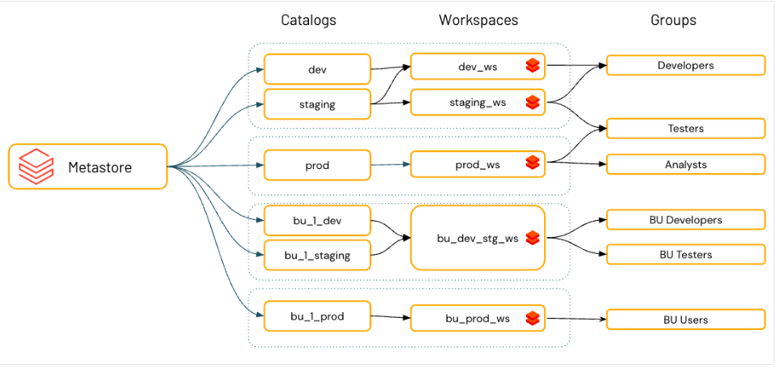
Example : Data Organization
Databricks recommends using catalogs to provide segregation across your organization's information architecture. Often this means that catalogs correspond to a software development environment scope, team, or business unit. If you use workspaces as a data isolation too
Heading
Heading
Heading
Heading
Heading
Heading

Slide 14
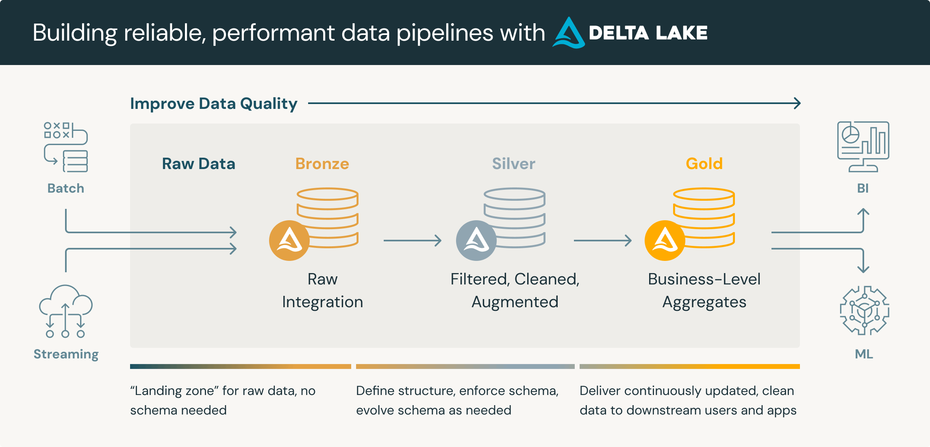
Medallion Architecture
A medallion architecture is a data design pattern used to logically organize data in a lakehouse, with the goal of incrementally and progressively improving the structure and quality of data as it flows through each layer of the architecture (from Bronze (Raw Data)⇒ Silver (Cleansed and conformed data) ⇒ Gold layer tables(Aggregated & Curated Data)). Medallion architectures are sometimes also referred to as "multi-hop" architectures.
Heading
Heading
Heading
Heading
Heading
Heading

Slide 15
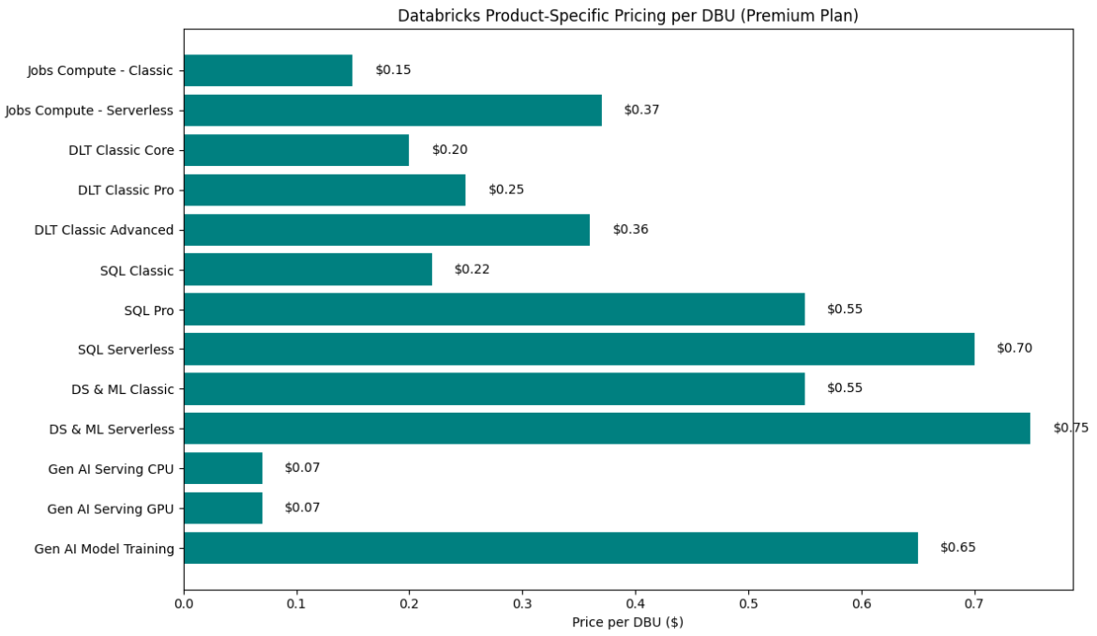
Cost
Heading
Heading
Heading
Heading
Heading
Heading

Slide 16
Conclusion
Data Governance is crucial for managing data effectively. Databricks offers comprehensive tools to support data governance, ensuring data integrity, security, and compliance.
Heading
Heading
Heading
Heading
Heading
Heading

Slide 17
Thank You!
Rahul Madimgiri : - Project - Cloud Data AI

